Slide 1
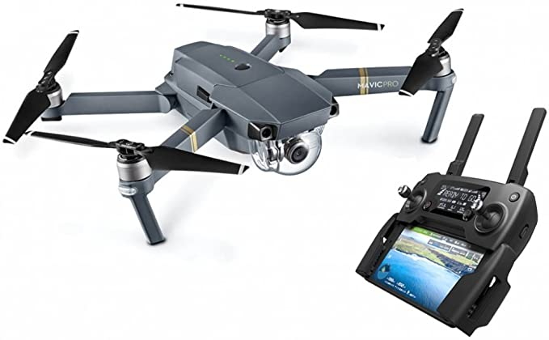

Drone detection
Introduction, motivations, scenario description
How it is possible to detect a drone?
Radar solutions and state of the art
Design of radar parameters, FMCW case
Micro Doppler introduction
Future plans

Slide 2
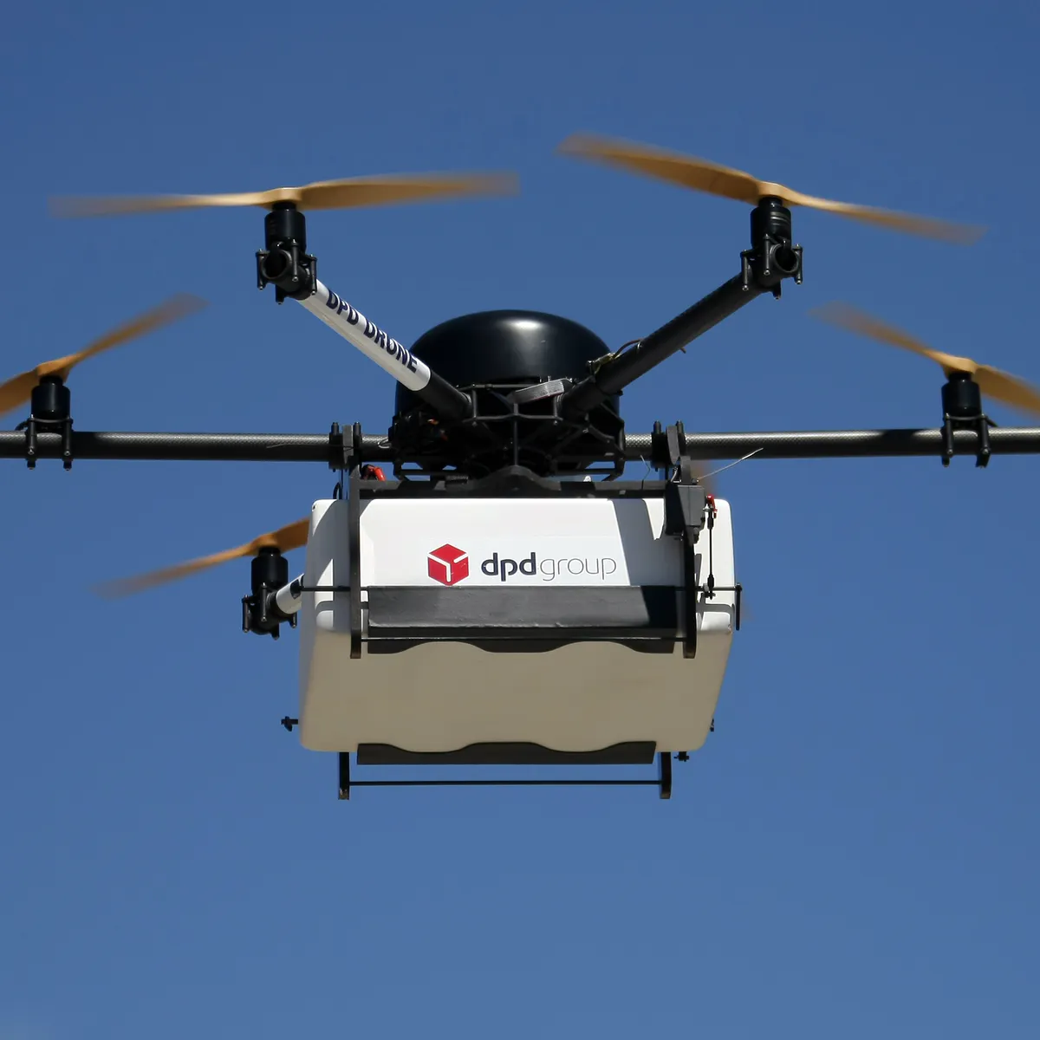
Motivations
Growth of incidents due to unauthorized drones:
Airport (Gatwick 2018), ISIS attacks with DJI Phantom bougth on Amazon (Syria 2016), Attempt to Venezuelan president Maduro (2018)
Low cost and ease of use, Off the shelf technology
Rapid technological evolution due to large benefits in several fields, agriculture engineering, package delivery, security

Slide 3

Environment
1. Military environment:
Complexity and expensive system of military level
2. Civil environment:
Low cost, simple and portable systems or fixed solutions
Airport, public institutions
Buildings, power plants, prisons
Crowded squares, public events
We select this context, characterized by presence of near people, near radio-frequency services and security problems like:
Privacy violation, transport of illegal stuff, spy

Slide 4
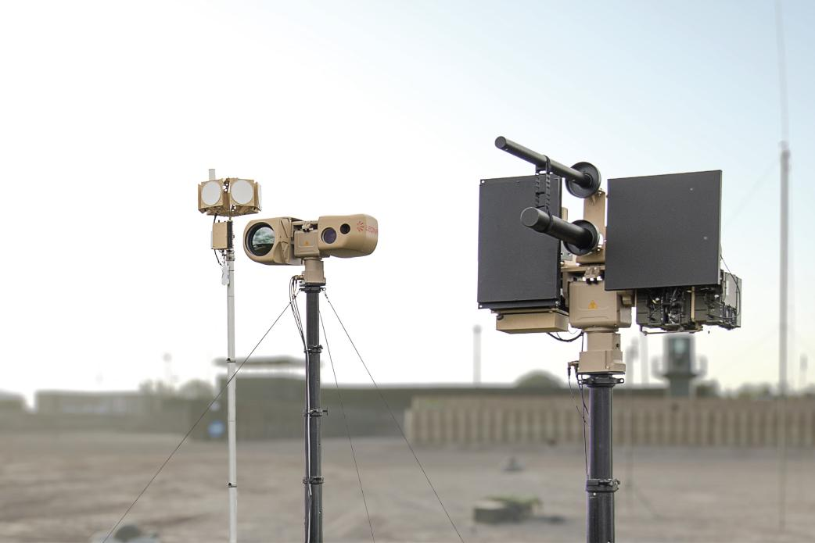
Anti Drone complete system
Detection solutions
Range of hunderd of m
Privacy
Thermal Optic/IR cameras
Radio Frequency RF scanner
Radar FMCW radar
Sound Acoustic sensors
Autonomous flight
More complete solution
Noise env.
Very short range
→ Hybrid is the most complete system
Phase 1: Detection + Recognition
Phase 2: Identification + Risk level
Phase 3: Neutralization

Slide 5
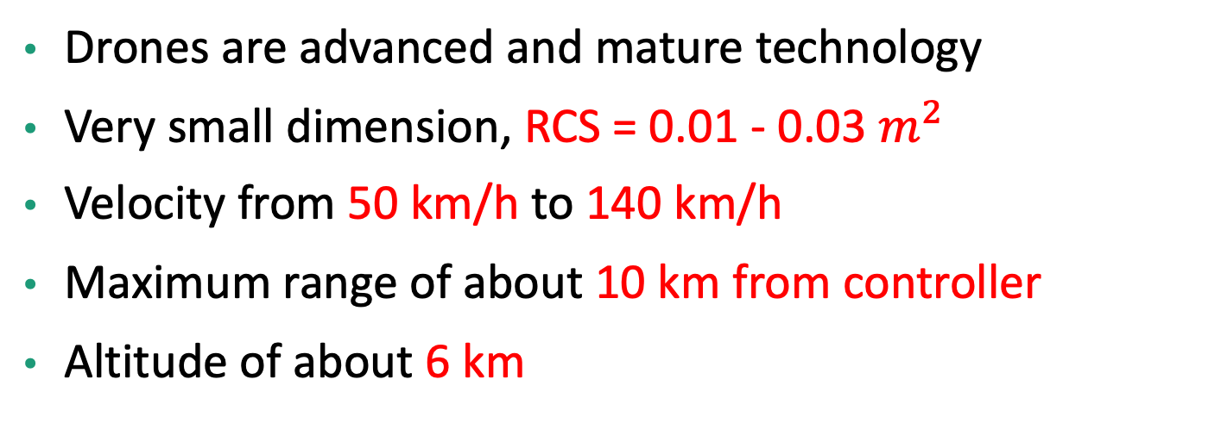
Difficulties and Goal
Drones are advanced and mature technology
Very small dimension, RCS = 0.01 - 0.03 $m^{2}$
Velocity from 50 km/h to 140 km/h
Maximum range of about 10 km from controller
Altitude of about 6 km
- Low cost HW
- Low power TX
- Small dimensions
- Easy to deploy
Goal:
Design a radar capable to detect and recognize this type of UAV with

Slide 6
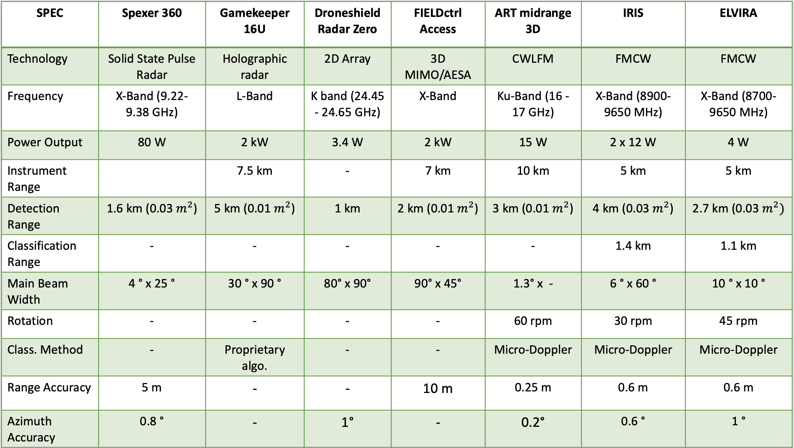
Actual solutions
Mosts are based on:
Above 8 GHz frequency bands
Good result achieved with FMCW radar
Recognition with Micro Doppler analysis
Transmitted power tens of Watt
Maximum detection range of 4 km

Slide 7
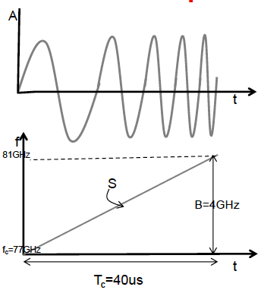
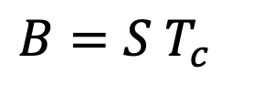
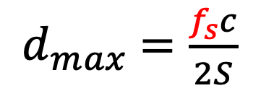
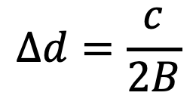
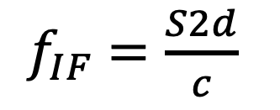
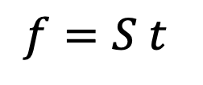
FMCW Radar parameters: distance
In order to dimension some parameters of FMCW radar
Chirp signal
IF frequency is the output of mixing tx signal and rx signal
$f_{IF}$ $=\frac{S2d}{c}$
Sampling frequency must be almost equal
to maximum IF frequency related to d max
Distance resolution is only related to the bandwidth
$d_{max}$ $=\frac{f_{s}c}{2S}$
$$∆d=\frac{c}{2B}$$
Where B is equal to:
$$B=S T_{c}$$
$$f=S t$$
2D FFT is performed to measure distance and velocities, on fast time and short time plane

Slide 8
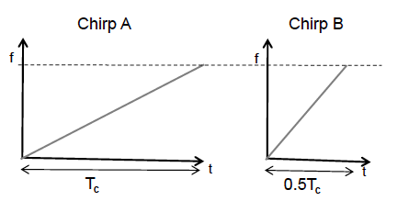
FMCW Radar parameters: B, S, Tc
Same B means same distance resolution,
But varying S and Tc is possible to:
A. Lower sampling frequency , lower IF bandwidth, means low cost ADC converter but lower maximum distance
B. Double slope, double sampling frequency, but half measurements time and higher maximum distance

Slide 9
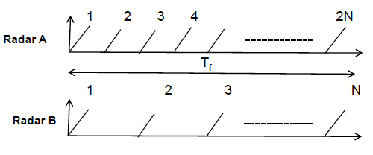
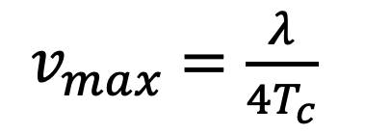
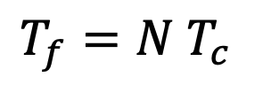
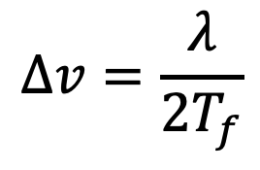
FMCW Radar parameters: velocities
In order to measure velocities, phase difference among N chirps must be computed
$v_{max}$ $=\frac{λ}{4T_{c}}$
Unanmbiguos velocity measurement, phase change must be minus than pi
$$∆v=\frac{λ}{2T_{f}}$$
Velocity resolution is related to the frame time of FFT
Same velocity resolution but:
A. Double N, half Tc means higher velocities measurable
Where Tf is equal to:
$$T_{f}=N T_{c}$$
B. Half N, double Tc means lower velocities measurable
N is the number of chirp transmitted

Slide 10

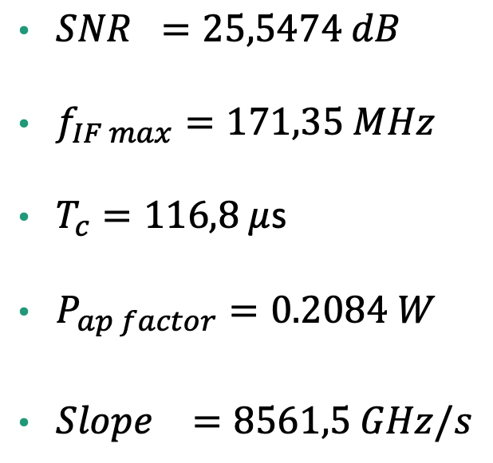
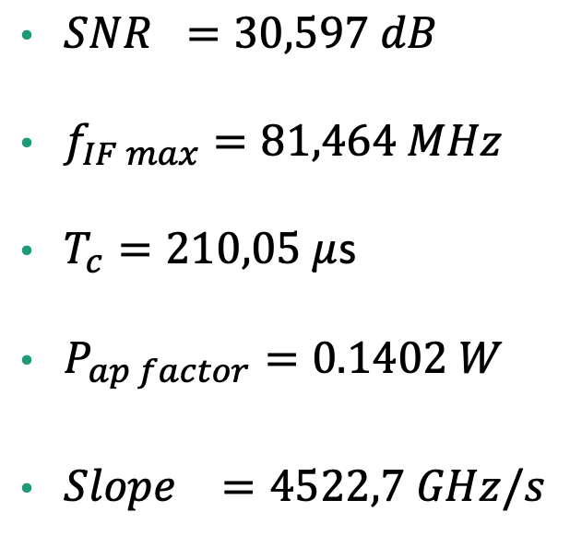
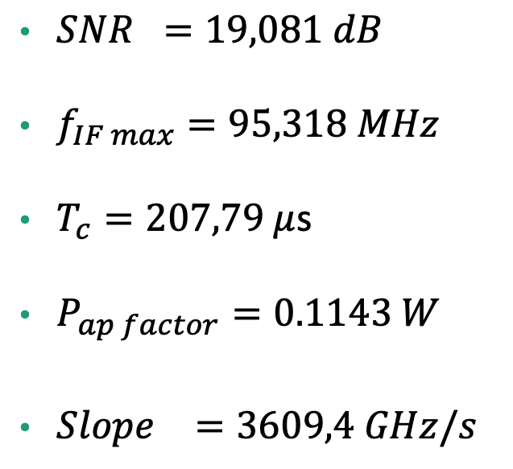
Some values of actual solutions
Considering the radar Surveillance Equation:
(Assuming L = 0 dB, Ts = 290K)
IRIS:
ELVIRA:
ART mid range 3D:
$SNR =19,081 dB$
$f_{IF max}=95,318 MHz$
$T_{c}=207,79 μ$s
$P_{ap factor}=0.1143 W$
${Slope}_{}=3609,4 GHz/s$
$SNR =30,597 dB$
$f_{IF max}=81,464 MHz$
$T_{c}=210,05 μ$s
$P_{ap factor}=0.1402 W$
${Slope}_{}=4522,7 GHz/s$
$SNR =25,5474 dB$
$f_{IF max}=171,35 MHz$
$T_{c}=116,8 μ$s
$P_{ap factor}=0.2084 W$
${Slope}_{}=8561,5 GHz/s$

Slide 11
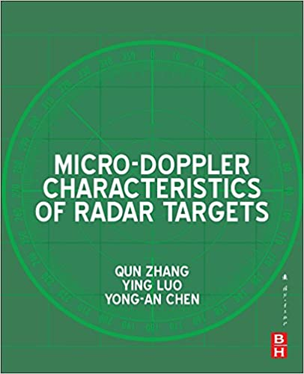
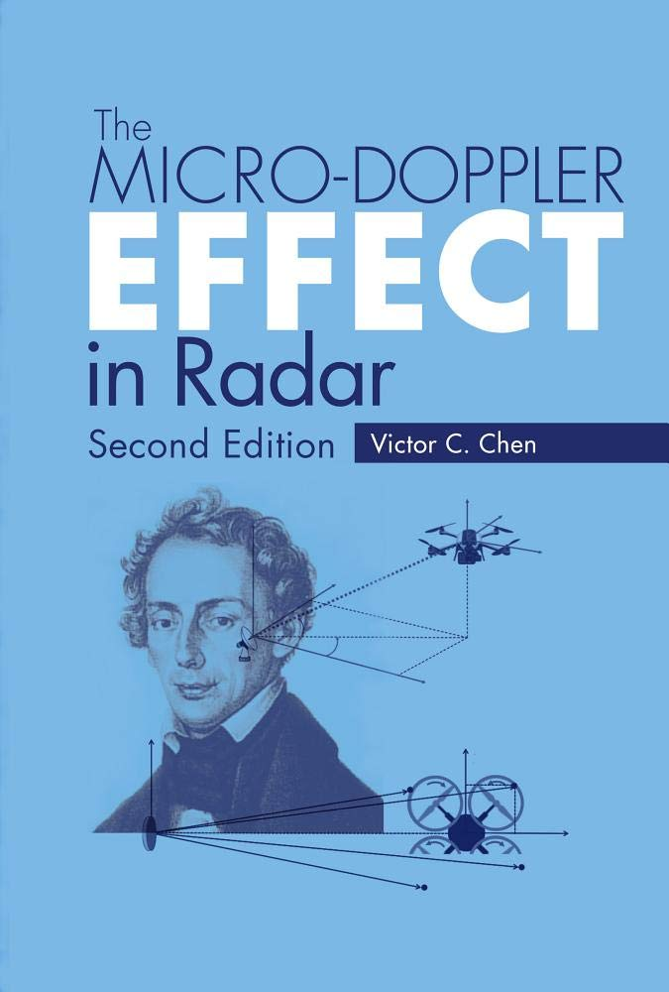
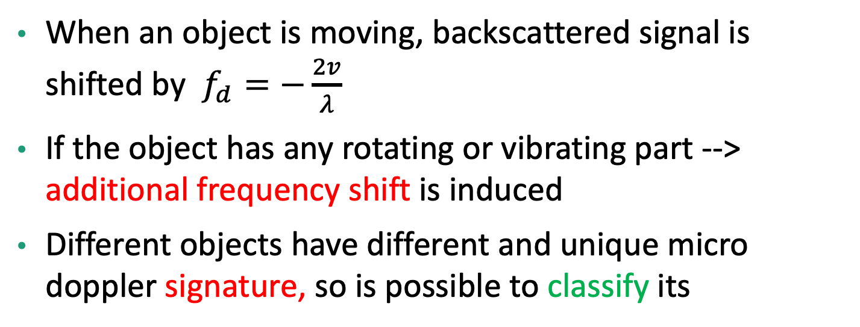
Micro Doppler
When an object is moving, backscattered signal is shifted by $f_{d}=−\frac{2v}{λ}$
If the object has any rotating or vibrating part --> additional frequency shift is induced
Different objects have different and unique micro doppler signature, so is possible to classify its
How is it possible to study it?
Fourier Transform is not capable to represent frequencies over time
Short Time Fourier Transform is an example of time-frequency distributions

Slide 12
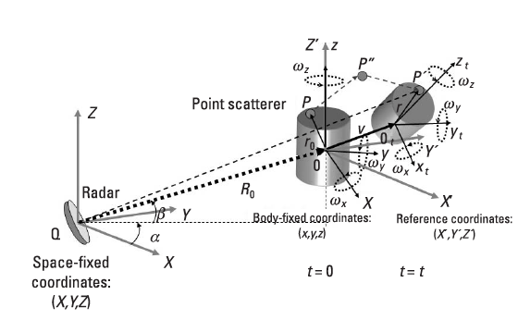


Micro Doppler
Considering a 3D model of a rigid body approximated by a single scatterer point
Target made a traslation from P to P’’ and then rotate from P’’ to P’
Rotations are represented by means of Euler angles by Rotation matrix, also called Roll, Pitch and Yaw matrix
For a target composed by multiple scatterer points the math became complex
Many approximations done: velocities much low than c, distance too large to consider EM in far field
Is possible to separate the contribution in frequency shift

Slide 13
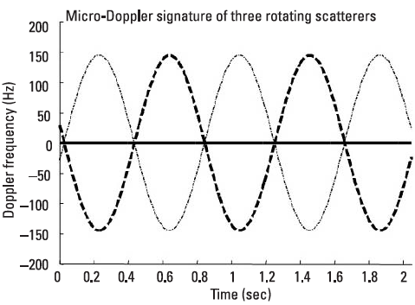

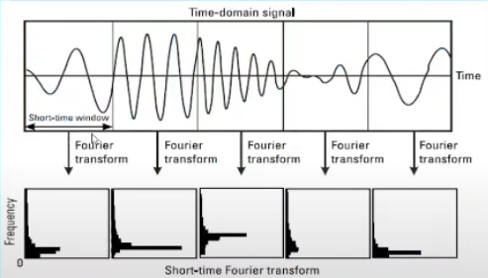

Micro Doppler
If we consider the temporal evolution of angular velocity, (Rodrigues formula), is possible to observe the evolution of frequency shift due to mD.
STFT, What is it?
Is like to do a FFT for each short time window

Slide 14
Next phase
Complete study about Micro Doppler in radar, difference between Wideband and Narrowband radar signals
Backscatter signal model for drone
Micro Doppler specific features in FMCW radar

Slide 15
Aumentando la durata del chirp diminuisco la frequenza di sampling, low cost adc
Il SNR finale è calcolato come l’integrazione di N segnali mandati sul target durante il dwell time (tempo speso sul tgt in una singola scansione)
Calcolo parametri radar con range più corto, quanta potenza mi serve?

